Slide 1
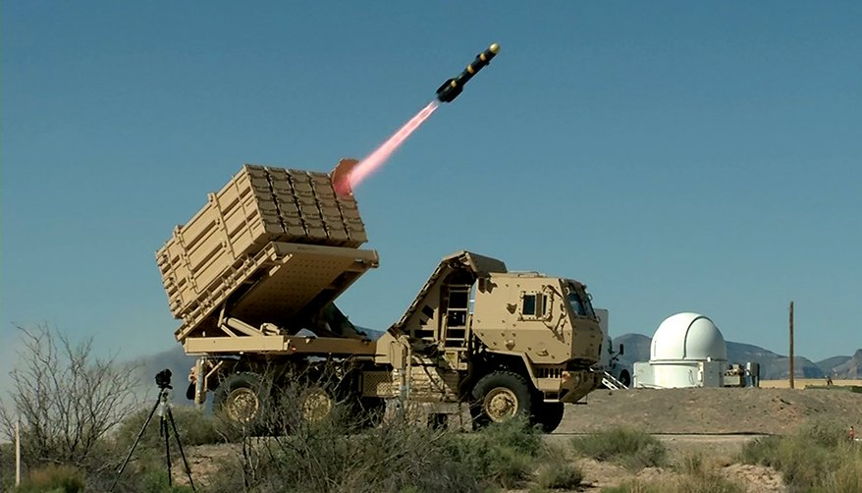
Face Tracking Laser System

Slide 2
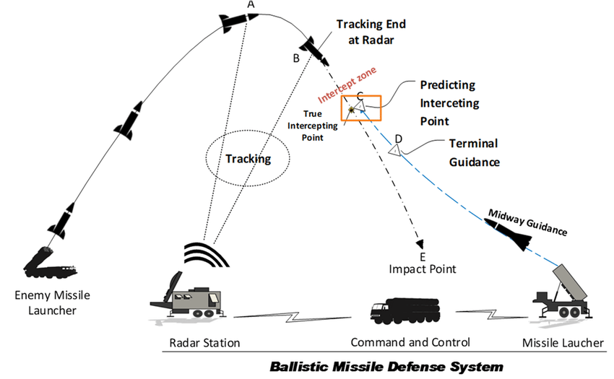
Description:
An Automatic Missile Defense System (AMDS) is a sophisticated military technology designed to detect, track, and intercept incoming missiles or other projectiles aimed at a defended area or asset.
The system operates autonomously or semi-autonomously, utilizing various sensors, data processing algorithms, and interception mechanisms to neutralize the threat in real-time.
Design components, including sensors (radar, lidar), motors (servo, stepper), firing mechanism, microcontroller board (Arduino), and ammunition.
Assemble the hardware components according to the design specifications, ensuring proper connections and compatibility between sensors, motors, and the firing mechanism.
Integrate the sensors with the microcontroller board to enable data acquisition and processing for threat detection and tracking.
Develop the software for the AMDS prototype, including control algorithms for sensor data processing, turret orientation control, and firing sequence execution.
Implement feedback control loops to ensure accurate turret positioning and precise timing of firing actions.

Slide 3
Objectives
Robotics
A I
Integrate unmanned ground vehicles (UGVs) into the AMDS for tasks such as reconnaissance, surveillance, or interception.
Develop algorithms for autonomous navigation and decision-making based on sensor inputs and mission objectives.
Enhance the perception capabilities of robotic platforms through sensor fusion techniques, integrating data from multiple sensors (e.g., cameras, lidar, radar) to improve situational awareness.
Design or procure a turret mechanism capable of aiming and firing in multiple directions. This turret should be capable of precise angular control to track and engage incoming threats effectively.
Develop AI algorithms to improve the accuracy of threat detection and classification, distinguishing between actual missile threats and false alarms.
Implement RL algorithms to learn optimal decision-making policies, considering factors such as missile trajectory, speed, and proximity to defended assets.
Develop RL algorithms that continuously learn and update interception trajectories and timing based on feedback from sensor data and previous interception attempts.

Slide 4
Components
Turret Assembly
Sensors
Microcontroller
Mechanism for aiming and firing, including azimuth (horizontal) and elevation (vertical) control.
Motors (such as servo motors or stepper motors) for turret movement.
Gear systems or pulleys for translating motor motion into turret movement.
Radar sensor for detecting and tracking incoming threats.
Radar sensor for detecting and tracking incoming threats.
Infrared sensors for detecting heat signatures of missile launches or re-entry vehicles.
Optical sensors for visual confirmation of threats.
Arduino board or similar microcontroller for processing sensor data and controlling turret movement and firing
Raspberry-pi for additional processing power may be required for complex algorithms and decision-making..
Firing Mechanism
Power supply
Communication Interfaces
Laser on target’s face.
Safety mechanisms to prevent accidental firing and ensure safe operation.
Batteries or power supply unit to provide electrical power to the system components.
Wired or wireless communication modules for data exchange between sensors, microcontroller board, and external systems.
Ethernet, Wi-Fi, or Bluetooth modules for network connectivity and remote monitoring/control.

Slide 5
Solutions
Solution 1
Solution 2
Solution 3
Designing the turret assembly and firing mechanism to withstand recoil forces generated during firing.
Implementing control algorithms to regulate motor speed, position, and acceleration/deceleration profiles for precise turret positioning.
Understanding the physics of sensor operation and signal processing techniques to extract relevant information from sensor data.
Solution 4
Solution 5
Solution 6
Utilize machine learning techniques such as deep learning and neural networks to analyze sensor data and identify patterns indicative of missile launches or trajectories.
Implement RL algorithms to learn optimal decision-making policies, considering factors such as missile trajectory, speed, and proximity to defended assets.
Develop RL algorithms that continuously learn and update interception trajectories and timing based on feedback from sensor data and previous interception attempts.

